Slide 1
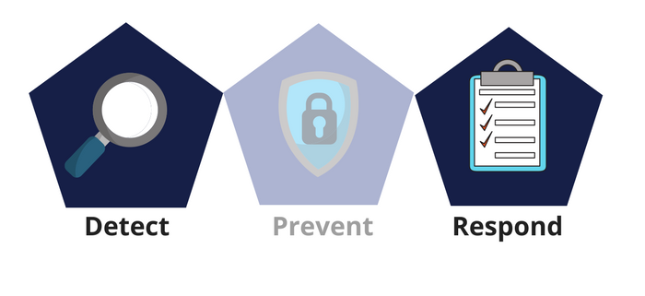



Network Security
Class X
lab 29

Slide 2

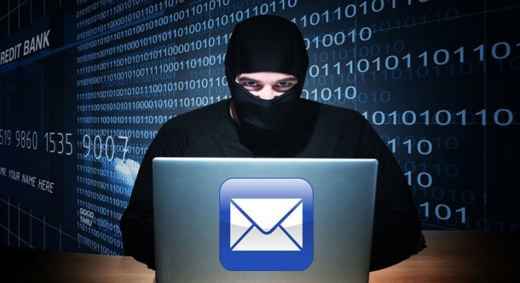
Email Hijacking
taking the full control of a target email

Slide 3
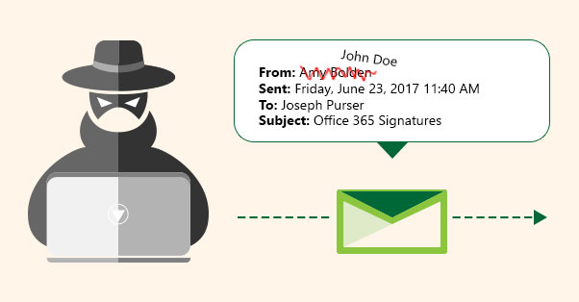
Email Spoofing
the spammer sends emails from a known domain, so the receiver thinks that he knows this person and opens the mail. Such mails normally contain suspicious links, doubtful content, requests to transfer money, etc.

Slide 4

Social Engineering
Spammers send promotional mails to different users, offering huge discount and tricking them to fill their personal data

Slide 5

Inserting Viruses
With the help of a virus, a hacker can take all your passwords

Slide 6

How to detect?
spam emails included your known person
your password works no longer

Slide 7

Password Hacking
once a hacker get the password of any system he can get access of that entire network

Slide 8
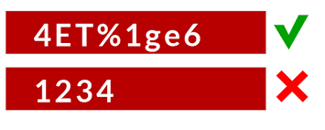
Strong Password
Contains at least 8 characters
A mix of letters, numbers, and special characters.
A combination of small and capital letters

Slide 9
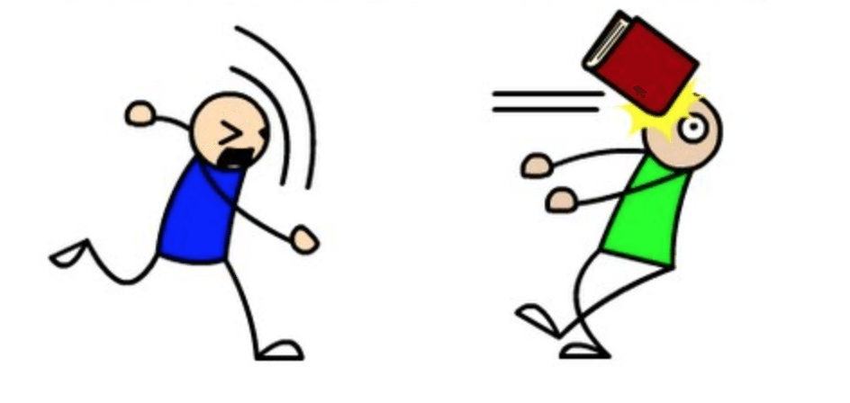
Dictionary Attack
In a dictionary attack, the hacker uses a predefined list of words from a dictionary to try and guess the password

Slide 10
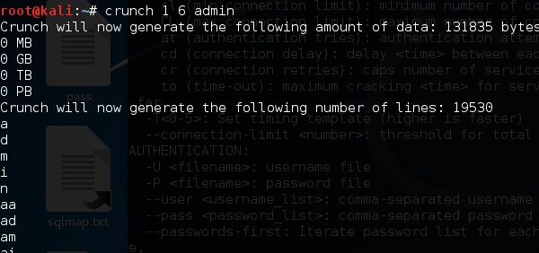
Hybrid Dictionary Attack
Hybrid dictionary attack uses a set of dictionary words combined with extensions

Slide 11

Brute-Force Attack
In a brute-force attack, the hacker uses all possible combinations of letters, numbers, special characters, and small and capital letters to break the password

Slide 12
Thank You

